Slide 1
MACHINE LEARNING BASIC CLASSIFICATION
Sindhu Wardhana
Teguh Prasetyo
Aris Budi Santoso
Leonard Yulianus

Slide 2
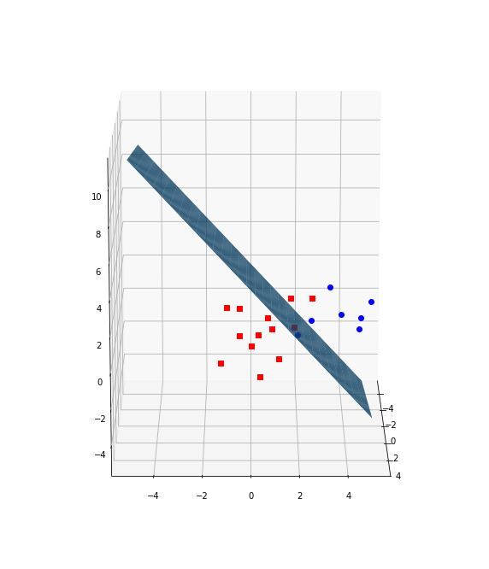
Classification
Classification is a task that requires the use of machine learning algorithms that learn how to assign a class label to examples from the problem domain [2]
[2] https://machinelearningmastery.com/types-of-classification-in-machine-learning/

Slide 3
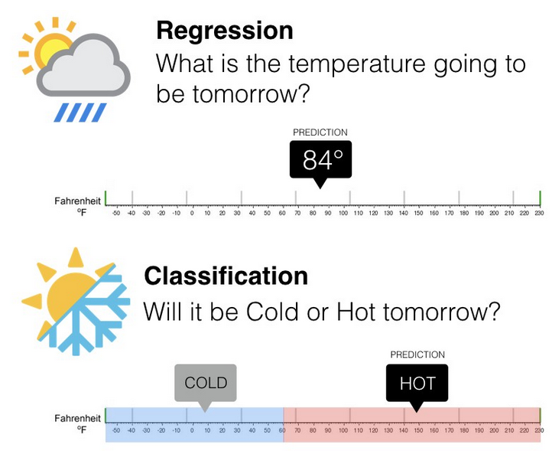
CLASSIFICATION VS REGRESSION
Regression | Classification
Digunakan untuk memprediksi data continuos (continuos quantity) | Digunakan untuk memprediksi label dikret pada suatu kelas (discrete class label)
Regresi dengan multiple input biasa disebut multivariate regression | Klasifikasi dengan 2 label kelas disebut binary dan lebih dari 2 kelas disebut dengan multi-class
Scoring yang umum digunakan : RMSE, R², MAE, MAPE | Scoring yang umum digunakan : Accuracy, F1-score, ROC-AUC
Contoh : prediksi harga rumah, prediksi GDP, prediksi pertumbuhan penduduk. | Contoh : fraud-detection, email spam filter,image classification.

Slide 4
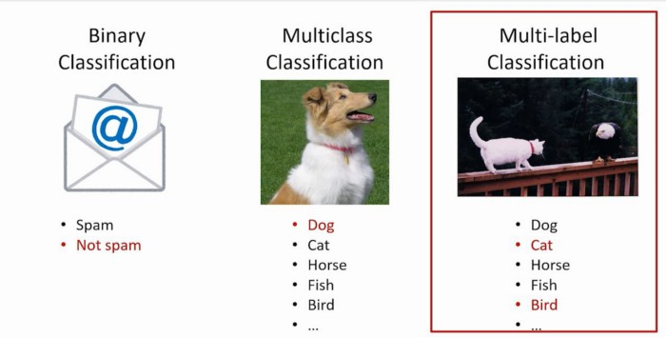
CLASSIFICATION TYPES
Classification
Binary
Multi-Label
Multi-Class
Imbalance

Slide 5
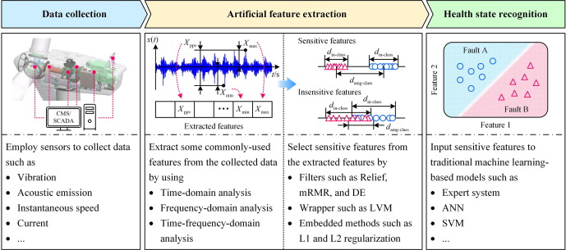
CLASSIFICATION CASE STUDIES
Failure detection
Fraud detection
Spam detection
Sentiment Analysis
https://www.sciencedirect.com/science/article/abs/pii/S0888327019308088

Slide 6
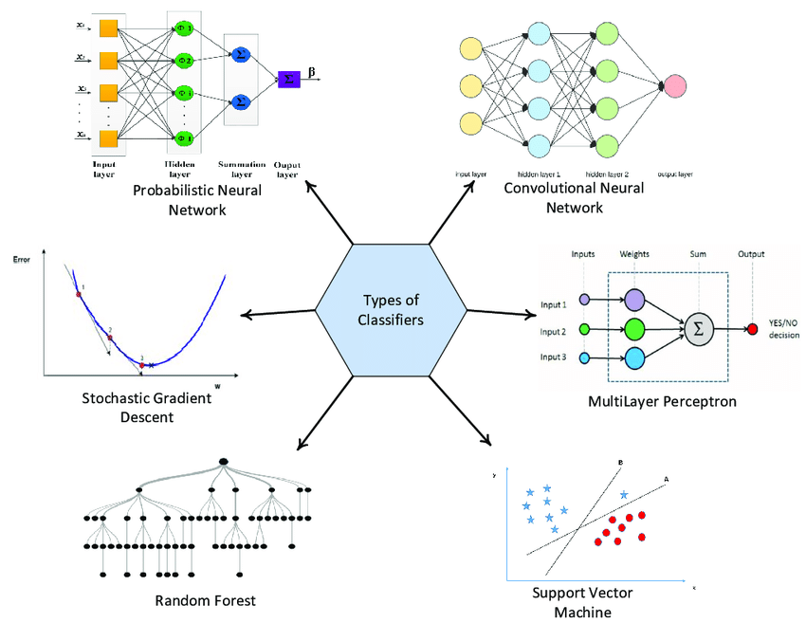
CLASSIFICATION ALGORITHMS
K Nearest Neighbor
Naïve Bayyes
Support Vector Machine
Logistic Regression
Decision Tree
Bagging : Random Forest
Boosting : AdaBoost, XGBoost, LGBM
Stacking : Voting
Artificial Neural Network

Slide 7
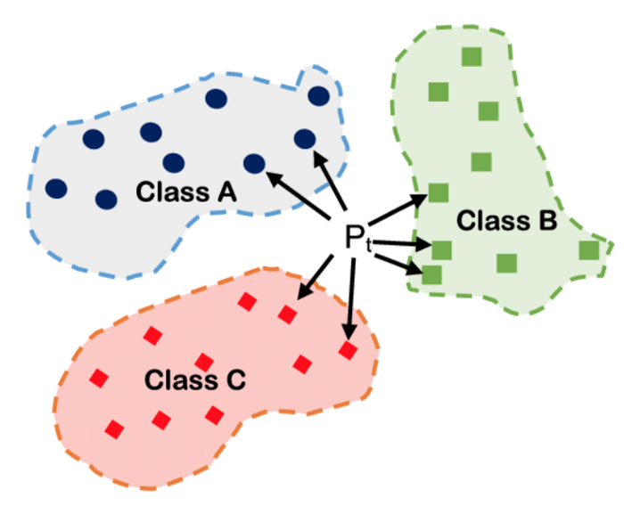
K NEAREST NEIGHBOR (K-NN)
Klasifikasi berdasarkan jarak antara titik (Eucleadean distance)
Menggunakan sejumlah titik terdekat (k) sebagai penentu

Slide 8
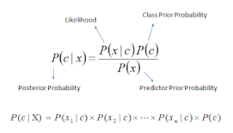
NAÏVE BAYES ALGORITHMS
Classification berdasarkan conditional probability, Bayes Theorem
Asumsi bahwa setiap predictor tidak saling terkait
c = Kelas/ kategori yang menjadi target prediksi
X = Data yang akan diprediksi kelasnya
x1, x2, x3, …. xn = Feature dari data X yang diprediksi kelasnya

Slide 9
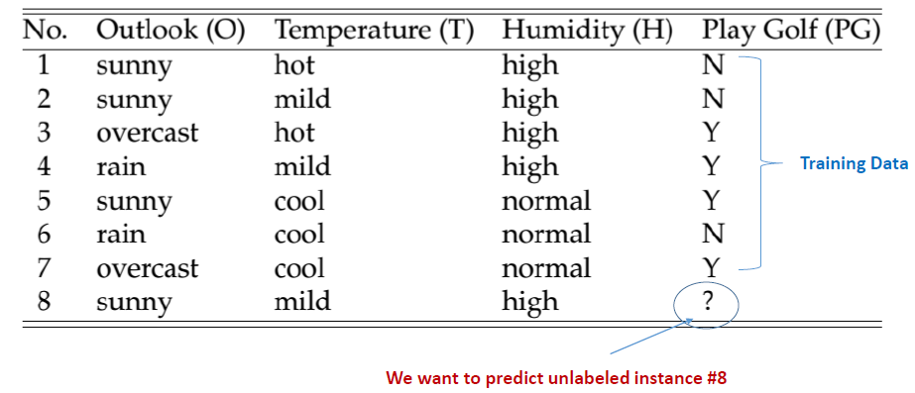
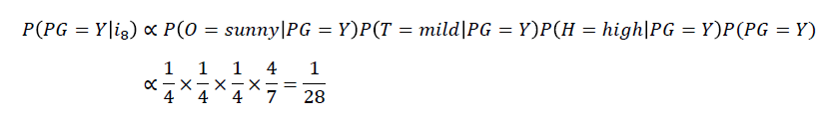
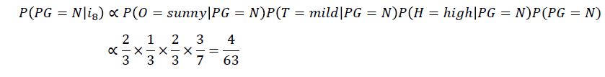
NAÏVE BAYESIAN ALGORITHMS
P(PG=Y|i8) > P(PN=Y|i8)
Sehinga kemungkinan Play Golf dengan kondisi i8 adalah NO

Slide 10
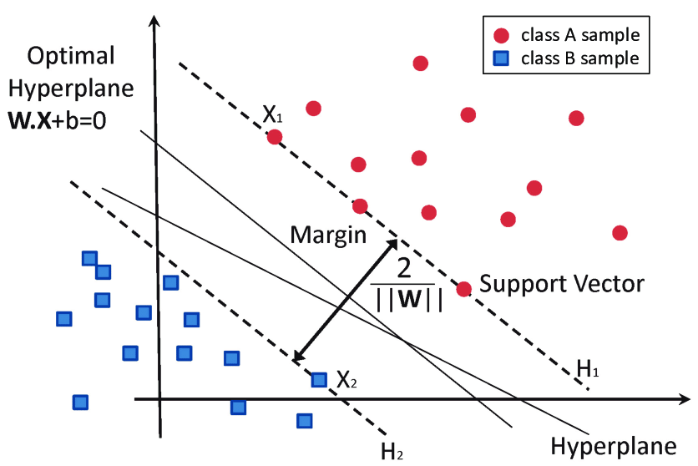
SUPPORT VECTOR MACHINE
Menemukan hyperplane yang optimal untuk membagi data ke dalam 2 atau lebih kelas
Hyperplane dapat linear maupun non linear

Slide 11
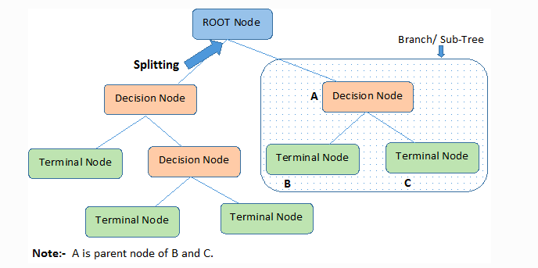
DECISSION TREE
Classification menggunakan alur berupa pohon keputusan
Menentukan root node
Menghitung Entropy dan Information Gain secara iterasi
Memilih atribut dengan Entropy paling rendah dan Information Gain paling tinggi

Slide 12
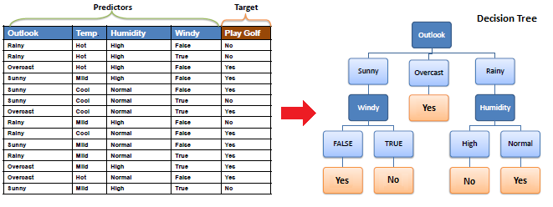
DECISSION TREE
https://www.saedsayad.com/decision_tree.htm

Slide 13
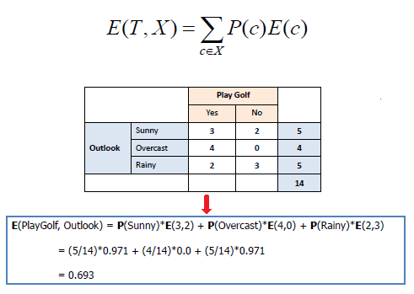
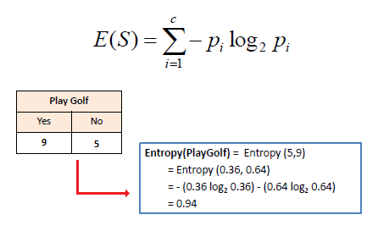
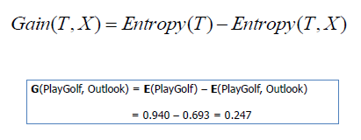
DECISSION TREE
https://www.saedsayad.com/decision_tree.htm

Slide 14
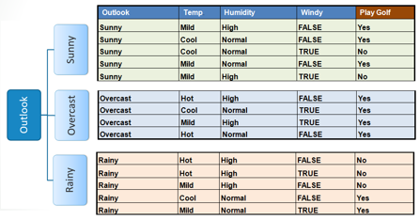
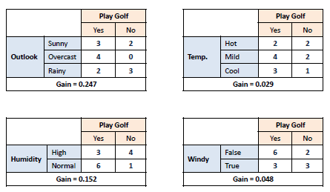
DECISSION TREE
https://www.saedsayad.com/decision_tree.htm

Slide 15
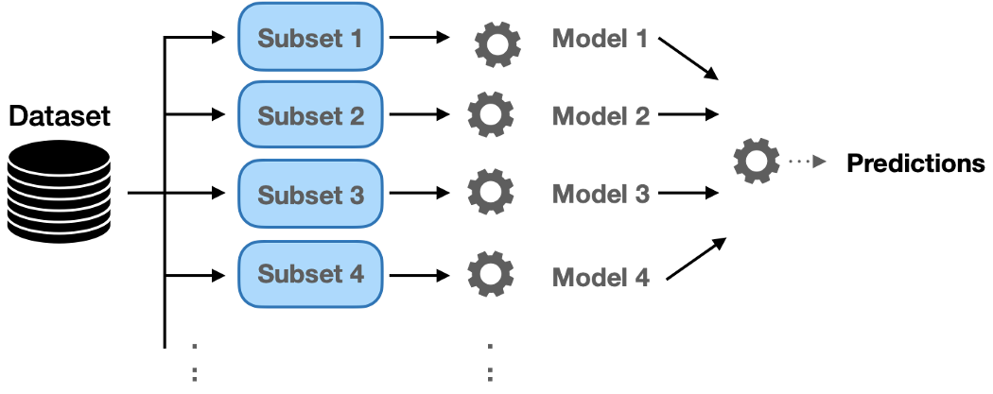
ENSEMBLE - BAGGING

Slide 16
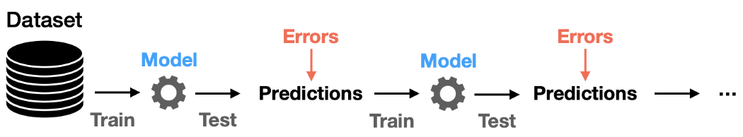
ENSEMBLE - BOOSTING

Slide 17
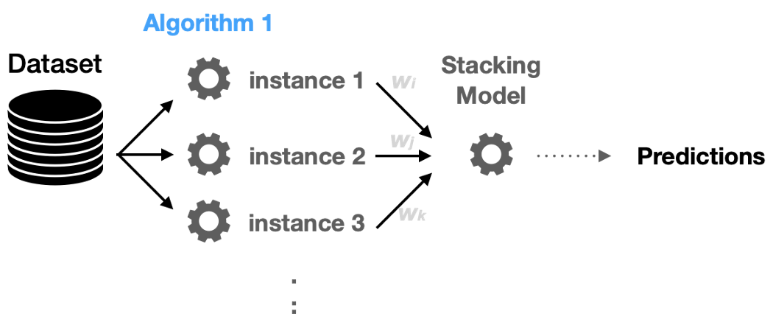
ENSEMBLE - STACKING

Slide 18
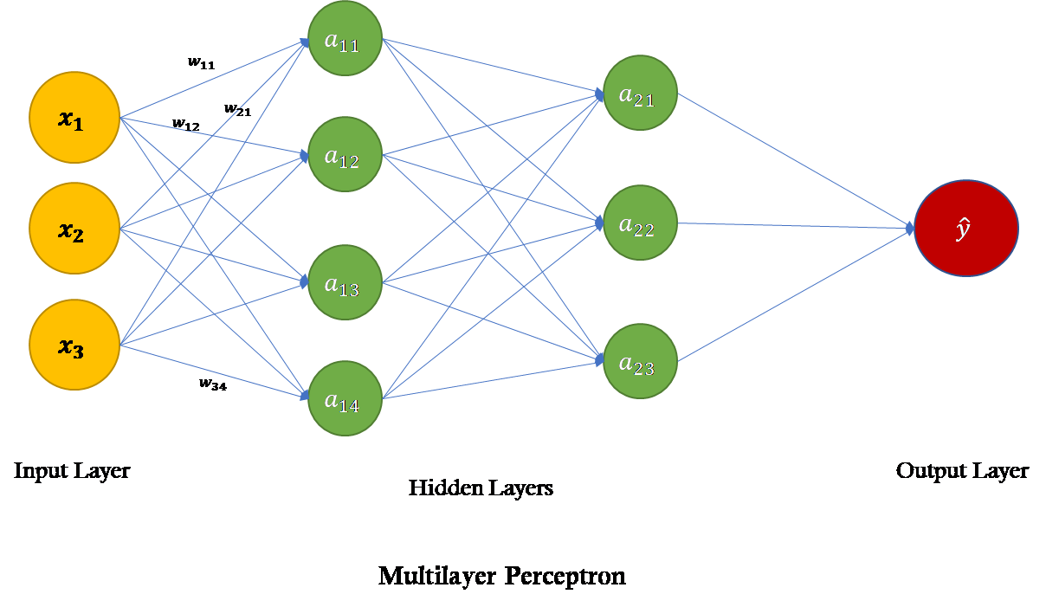
ARTIFICIAL NEURAL NETWORK
https://towardsdatascience.com/power-of-a-single-neuron-perceptron-c418ba445095

Slide 19
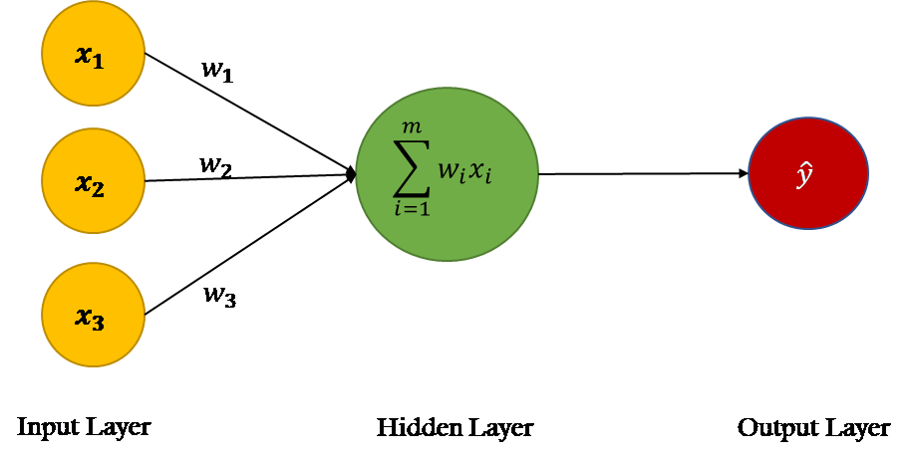
ARTIFICIAL NEURAL NETWORK
https://towardsdatascience.com/power-of-a-single-neuron-perceptron-c418ba445095

Slide 20
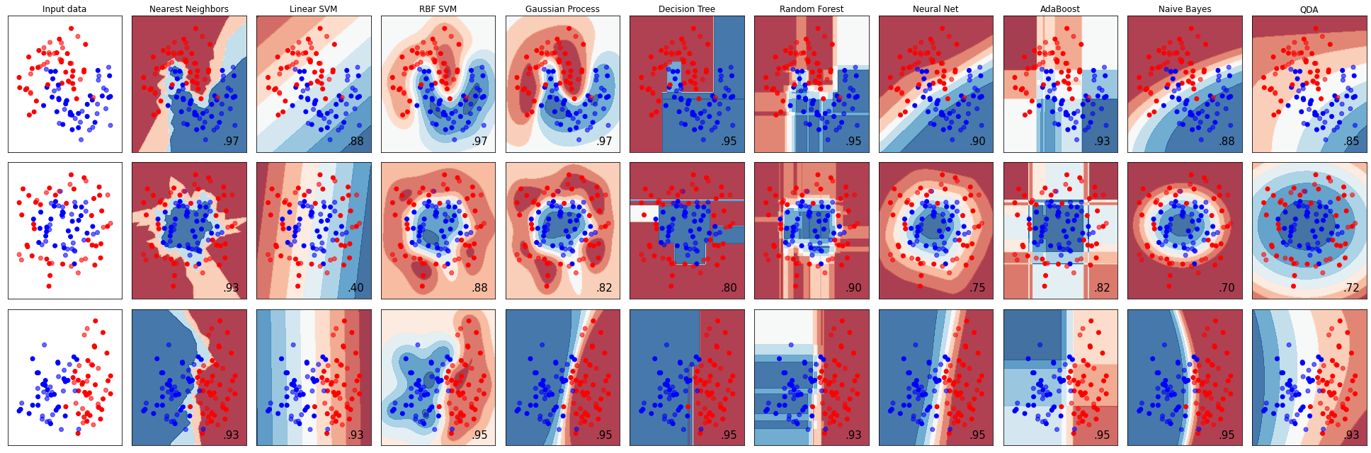
CLASSIFICATION ALGORITHMS
https://scikit-learn.org/stable/auto_examples/classification/plot_classifier_comparison.html

Slide 21
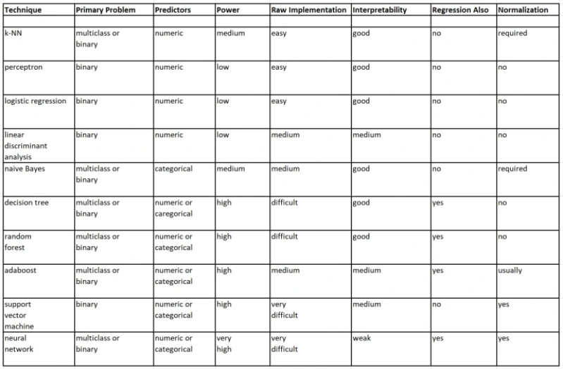
Classification Algorithm Comparison
https://jamesmccaffrey.wordpress.com/2018/11/07/a-comparison-of-ten-machine-learning-classification-algorithms/

Slide 22
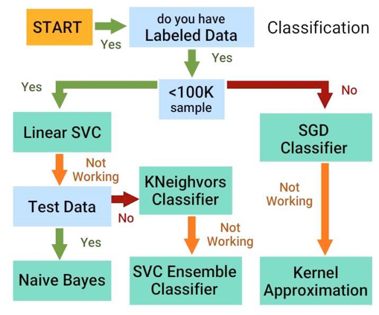
CLASSIFICATION METHODS

Slide 23
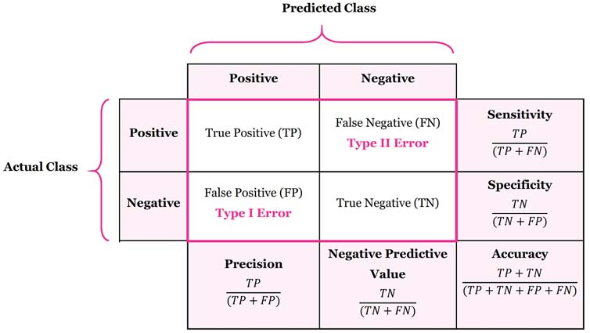
MODEL EVALUATION (CONFUSSION MATRIX)

Slide 24
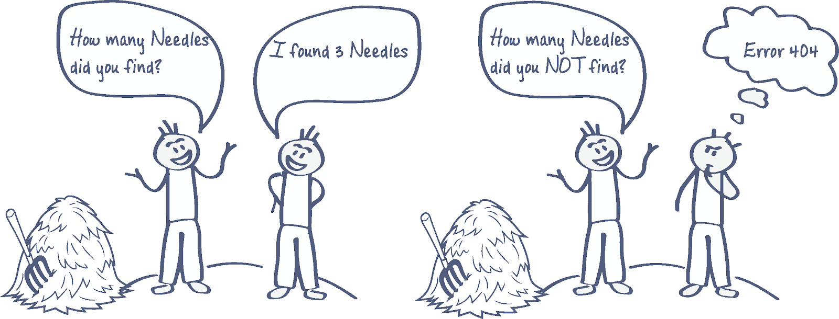
MODEL EVALUATION
Why is accuracy not a good measurement of success for secrets detection?
https://blog.gitguardian.com/secrets-detection-accuracy-precision-recall-explained/

Slide 25
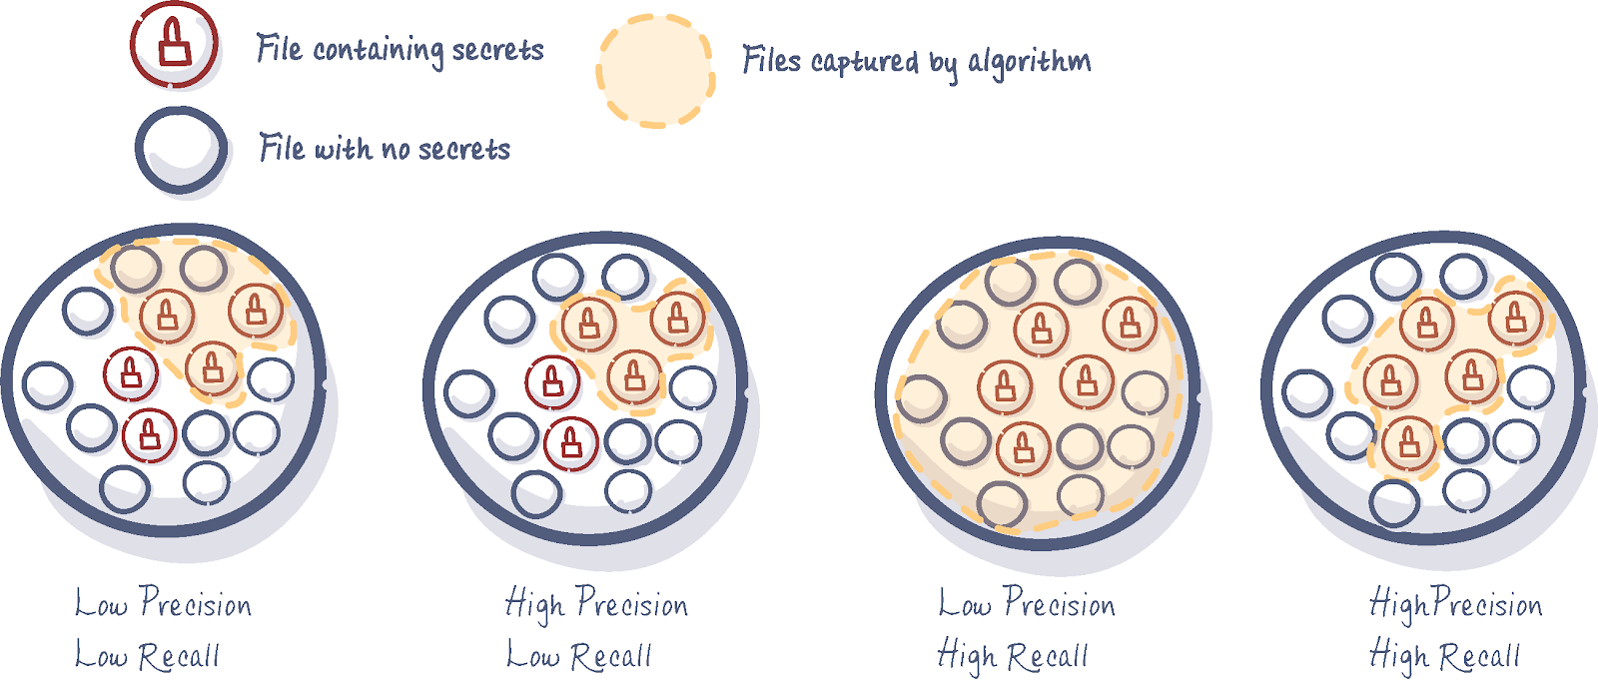
MODEL EVALUATION (Precision and Recall)
https://blog.gitguardian.com/secrets-detection-accuracy-precision-recall-explained/

Slide 26
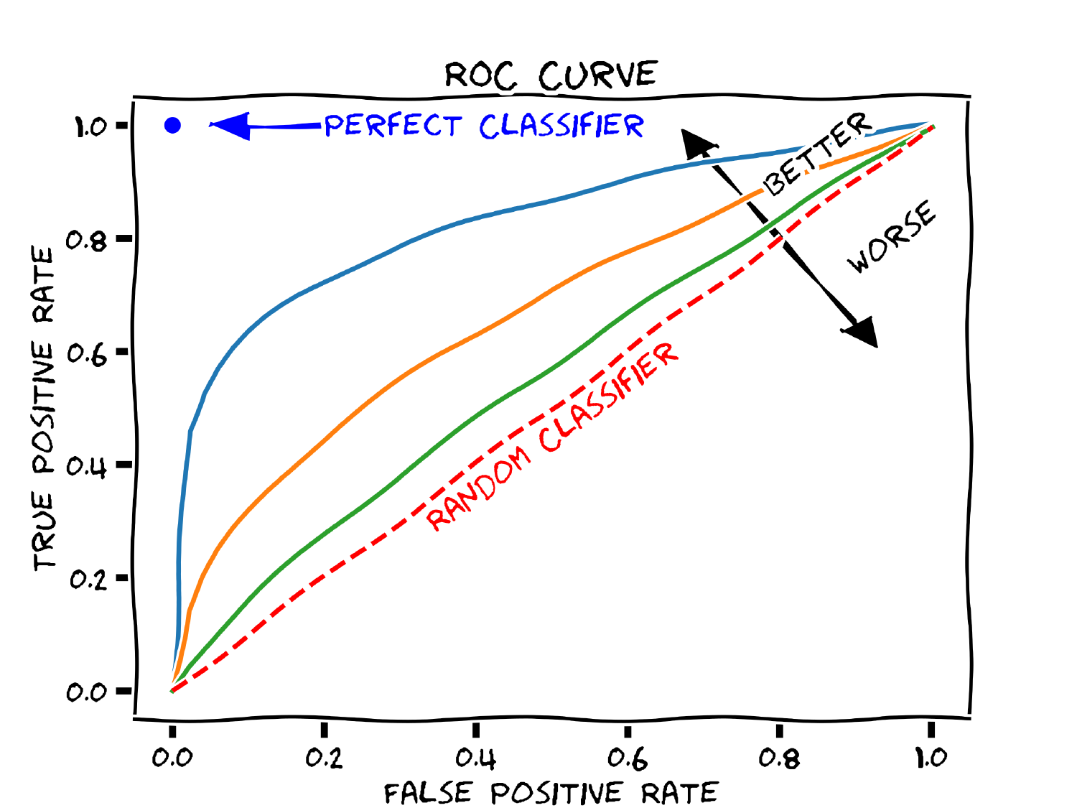
MODEL EVALUATION (AUC - ROC)

Slide 27

CONTOH PENERAPAN PADA PYTHON

Slide 28

TERIMA KASIH

